Slide 1

FPT University
Android programMing
Lesson 14
Version 1.0

Slide 2
Agenda
Google Firebase
Firebase Cloud Messaging

Slide 3
Google Firebase
What is Firebase? Before being acquired by Google in 2014, Firebase started out as an independent company providing cloud-based solutions such as real-time database, analytics, messaging, notification and crash reporting services to web and mobile app developers. Firebase essentially consists of a set of cloud services, programming interfaces and libraries combined with a web-based console through which the services are managed.
https://firebase.google.com/

Slide 4
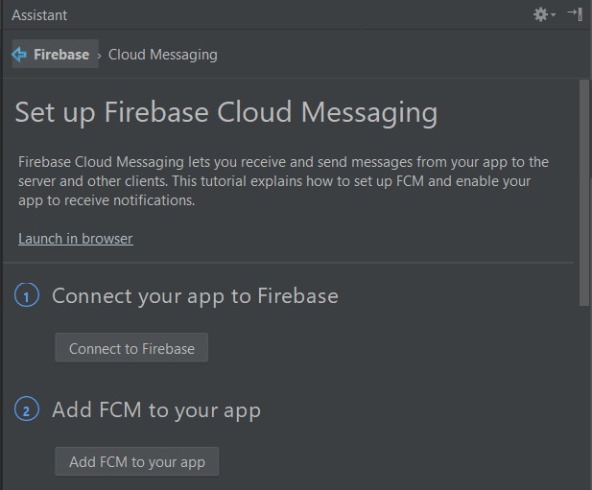
Google Firebase
Connecting the Project to Firebase

Slide 5
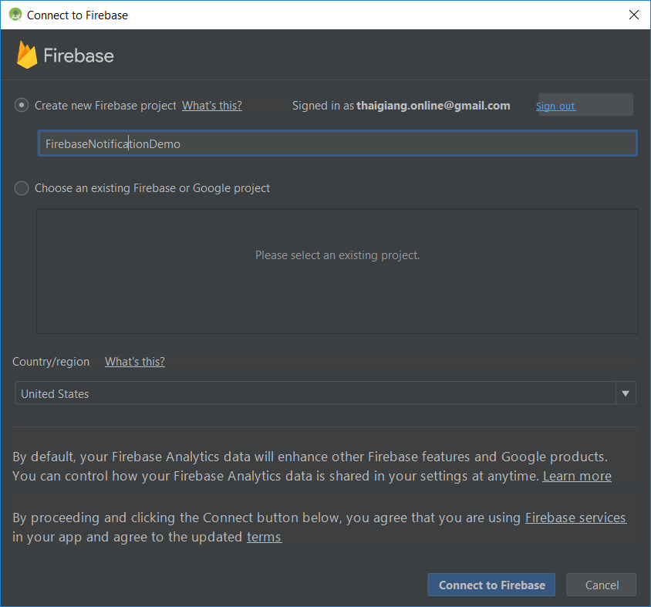
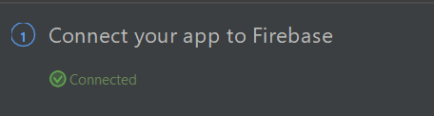
Google Firebase
Creating a New Firebase Project

Slide 6
Google Firebase
The google-services.json File - As part of the process of connecting the app to the Firebase project, a file named googleservices.json will have been added to the Android Studio project. After connect project to Google Firebase, the JSON file will be downloaded automatically.
- Get a look at googleservices.json
Notes:
FirebaseNotificationDemo\app\googleservices.json

Slide 7
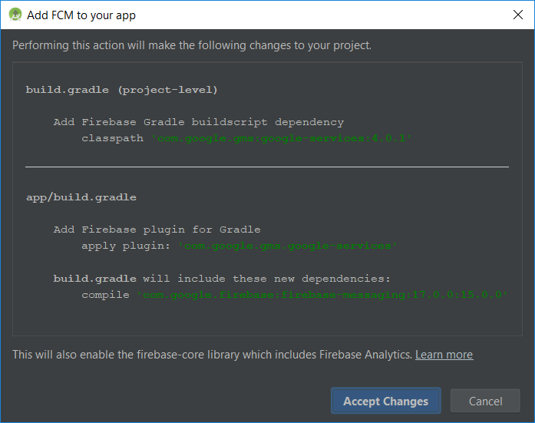
Google Firebase
Adding the Firebase Libraries

Slide 8
Firebase Cloud Messaging
Launching the application Begin by launching the FirebaseNotify app created in the previous chapter on a physical Android device. Once the app is running, place it into the background by tapping the circular home button in the bottom status bar. By default notifications of this type are only delivered to apps that are either not running, or currently in the background.

Slide 9
Firebase Cloud Messaging
Sending a Firebase Notification
Open a web browser and navigate to https://console.firebase.google.com/

Slide 10
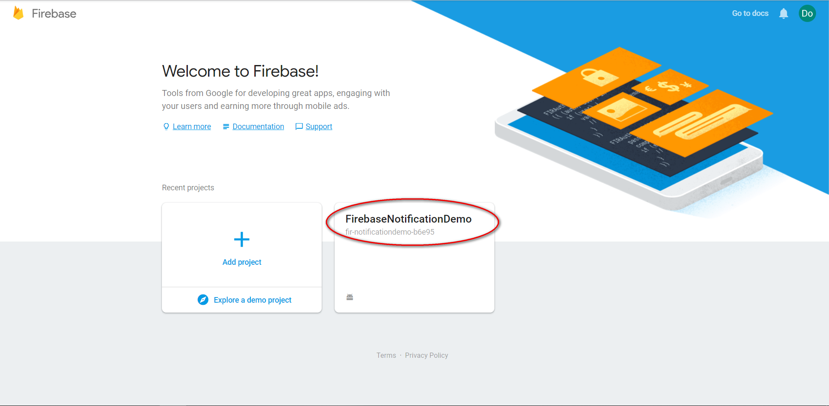
Firebase Cloud Messaging
Locate to the demo project

Slide 11
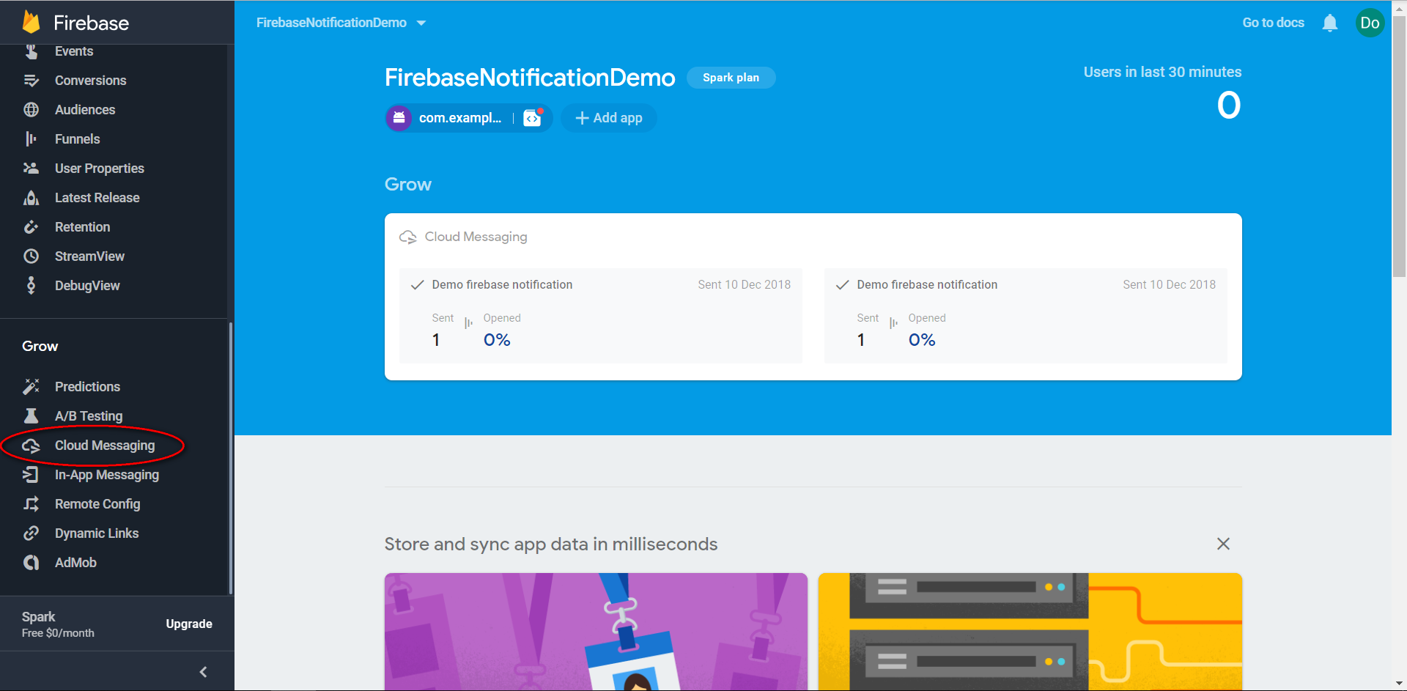
Firebase Cloud Messaging

Slide 12
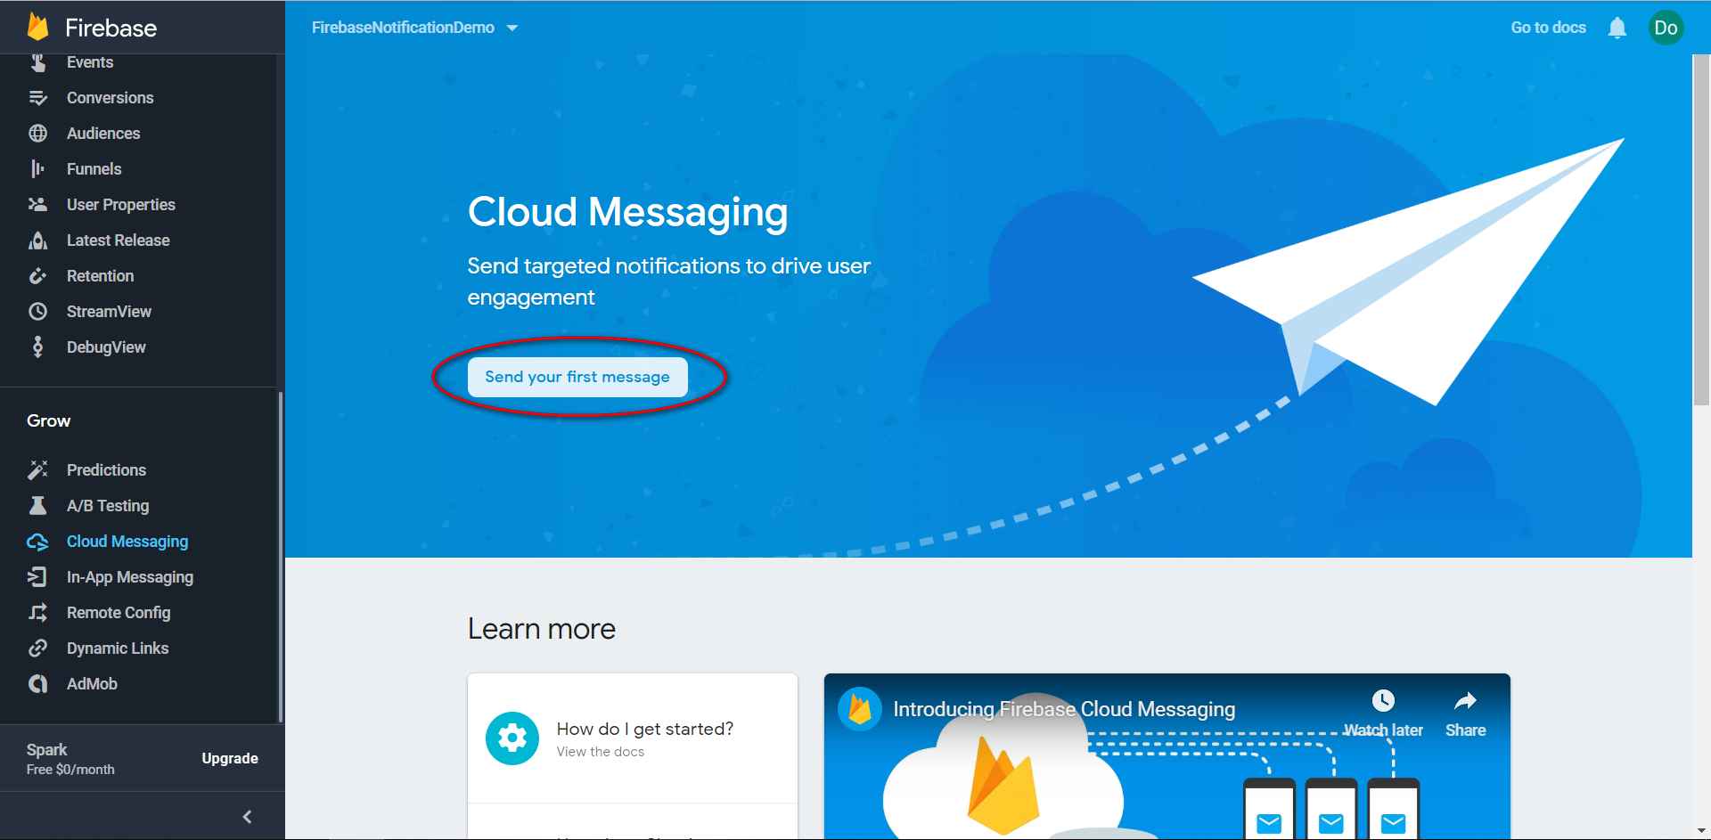
Firebase Cloud Messaging

Slide 13
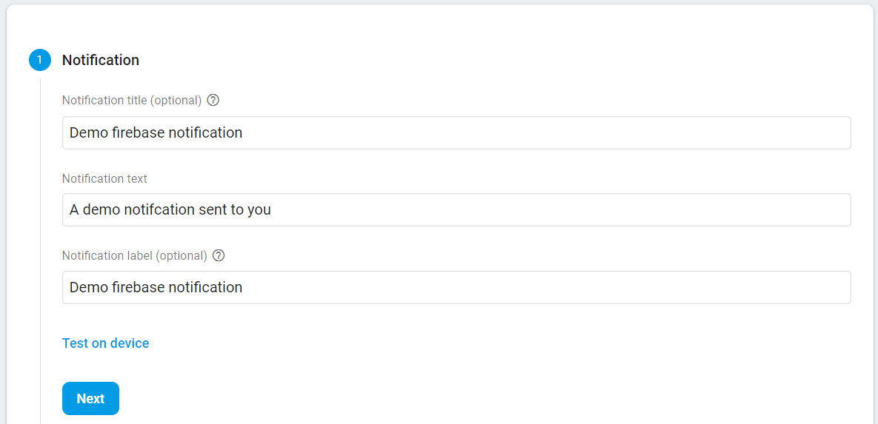
Firebase Cloud Messaging

Slide 14
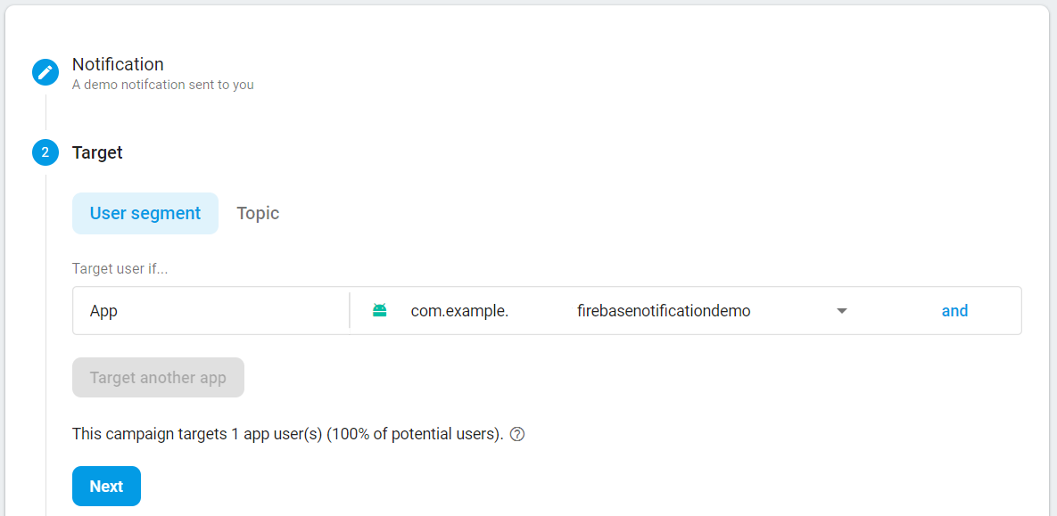
Firebase Cloud Messaging

Slide 15
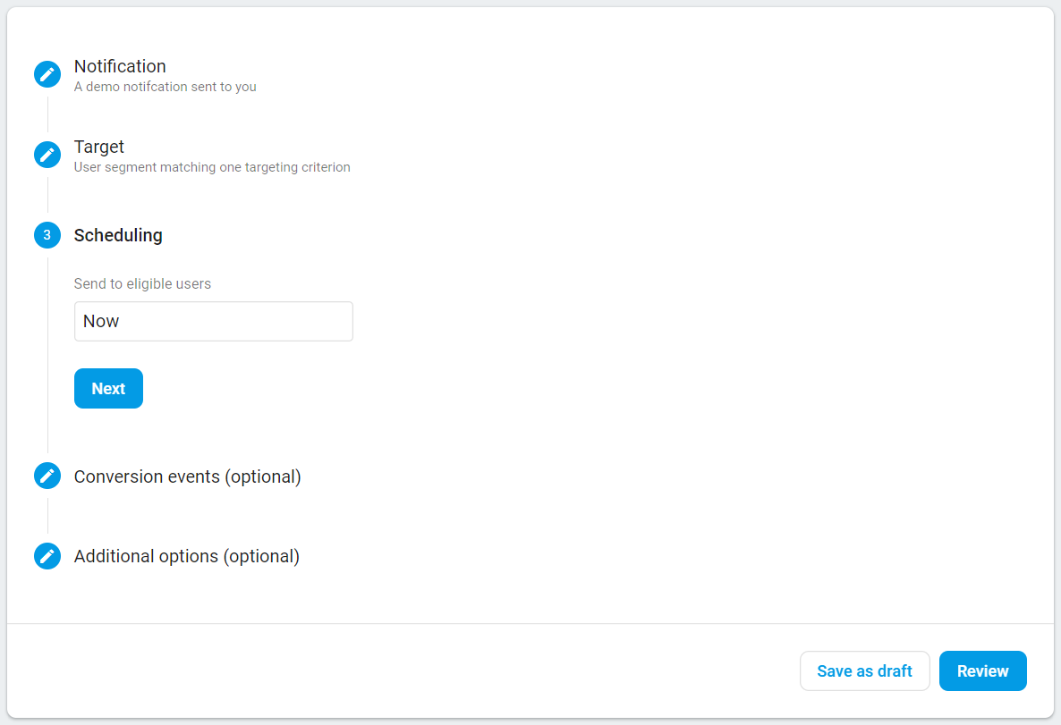
Firebase Cloud Messaging

Slide 16
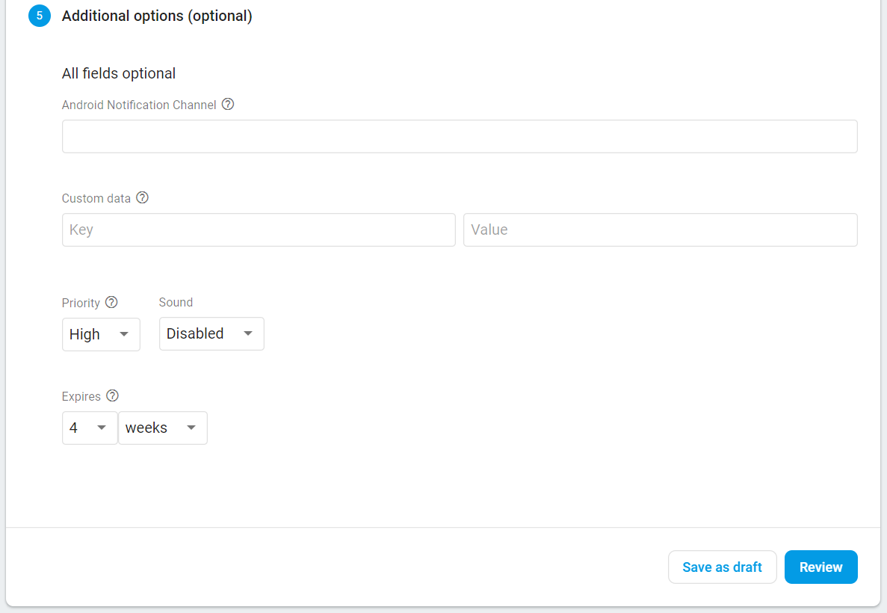
Firebase Cloud Messaging

Slide 17
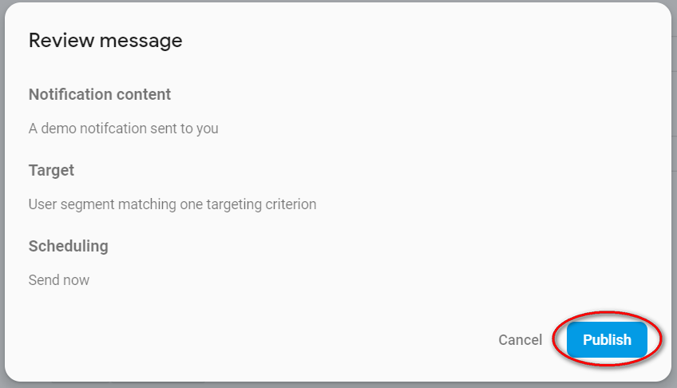
Firebase Cloud Messaging

Slide 18
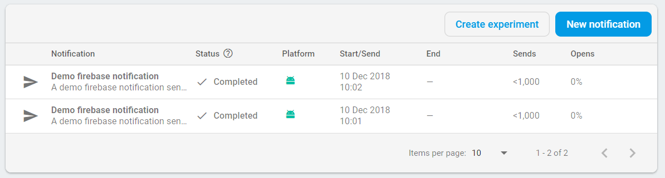
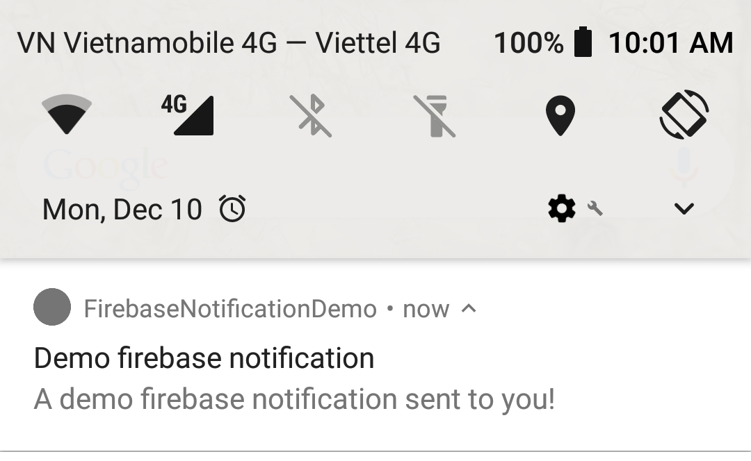
Firebase Cloud Messaging

Slide 19
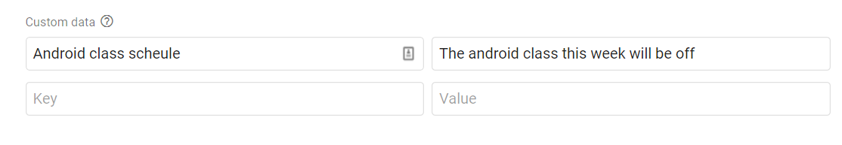
Firebase Cloud Messaging
Including Custom Data within the Notification
Firebase messaging also provides the option to pass key-value based data within the notification.This data can then be retrieved by the activity that is launched when the notification is selected on the device

Slide 20
Firebase Cloud Messaging
Foreground App Notification Handling

Slide 21
Firebase Cloud Messaging
Retrieving custom data
@Override protected void onCreate(Bundle savedInstanceState) { super.onCreate(savedInstanceState); setContentView(R.layout.activity_firebase_notification); Bundle customData = getIntent().getExtras(); if (customData != null) { TextView textView = (TextView) findViewById(R.id.textView); textView.setText(customData.getString("MyKey1")); } }

Slide 22
Firebase Cloud Messaging
Testing receive custom data.

Slide 23
Firebase Cloud Messaging
Foreground App Notification Handling
app will not, by default, receive a Firebase notification if it is currently the foreground app. In order for a foreground app to receive the notification, it must implement a service that extends the FirebaseMessagingService class and override the onMessageReceived() method within that class.

Slide 24
Firebase Cloud Messaging
Create message service
public class ForcegroundMessageHandleService extends FirebaseMessagingService { public ForcegroundMessageHandleService() {
} String TAG = "Firebase notification"; @Override public void onMessageReceived(RemoteMessage remoteMessage) { Log.d(TAG, "Notification Title: " + remoteMessage.getNotification().getTitle()); Log.d(TAG, "Notification Message: " + remoteMessage.getNotification().getBody()); } }

Slide 25
Firebase Cloud Messaging
Add intent filter for service
<service android:name=".ForcegroundMessageHandleService" android:enabled="true" android:exported="true"> <intent-filter> <action android:name="com.google.firebase.MESSAGING_EVENT"/> </intent-filter> </service>

Slide 26
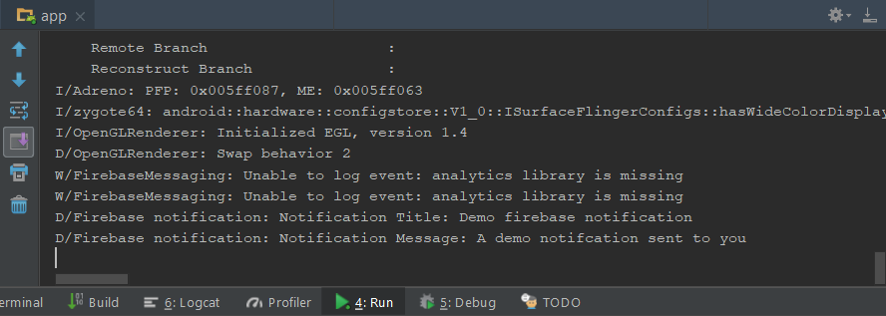
Firebase Cloud Messaging
Testing notification delivered on force ground activity

Slide 27
Firebase Cloud Messaging
Sending message to main activity using broadcast intent
@Override public void onMessageReceived(RemoteMessage remoteMessage) { Intent intent = new Intent(); Bundle extras = new Bundle(); extras.putString("Title",remoteMessage.getNotification().getTitle()); extras.putString("Message",remoteMessage.getNotification().getBody()); for (Map.Entry<String, String> entry : remoteMessage.getData().entrySet()) { String key = entry.getKey(); String value = entry.getValue(); extras.putString(key, value); } intent.putExtras(extras); intent.setAction("com.my.app.onMessageReceived"); sendBroadcast(intent); }

Slide 28
Firebase Cloud Messaging
Implement BroadCastReceiver on main activity
private class MyBroadcastReceiver extends BroadcastReceiver { @Override public void onReceive(Context context, Intent intent) { Bundle extras = intent.getExtras(); String message = ""; for (String key: extras.keySet()) { message += key + ": " + extras.getString(key) + "\n"; } updateView(message);//update your textView } } public void updateView(String text){ TextView textView = findViewById(R.id.textView); textView.setText(text); }

Slide 29
Firebase Cloud Messaging
Register intent filter for BroadCastReceiver
@Override protected void onResume() { super.onResume(); IntentFilter intentFilter = new IntentFilter(); intentFilter.addAction("com.my.app.onMessageReceived"); MyBroadcastReceiver receiver = new MyBroadcastReceiver(); registerReceiver(receiver, intentFilter); }

Slide 30
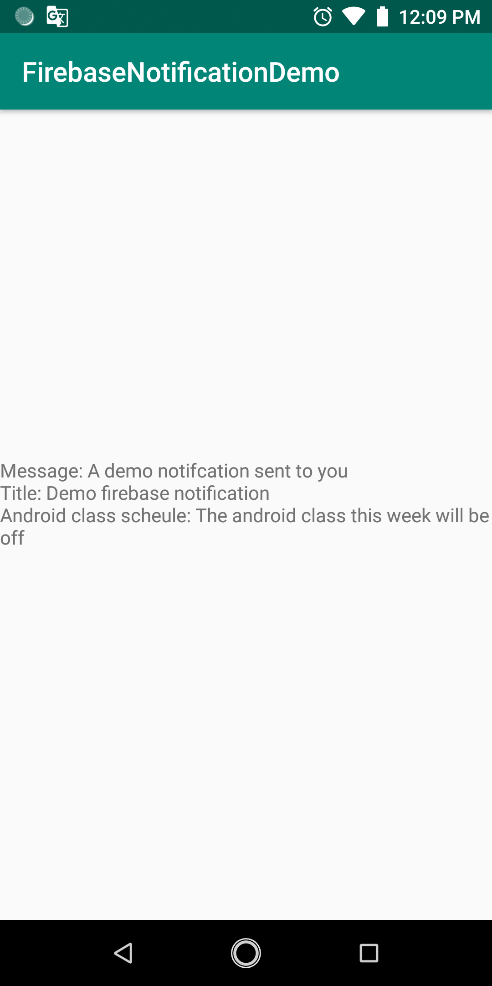
Firebase Cloud Messaging
Testing for final application

Slide 31

End of Lesson 14

Slide 32
Thank you!

